Slide 1
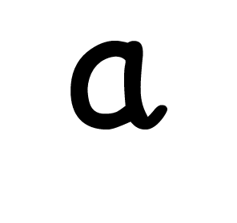
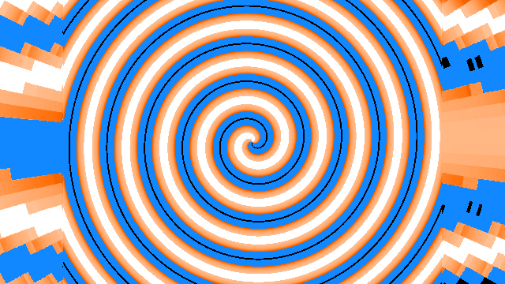
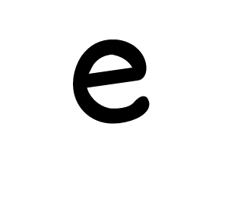
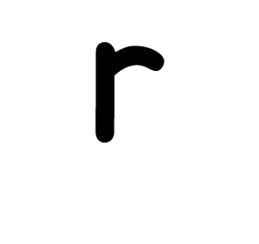
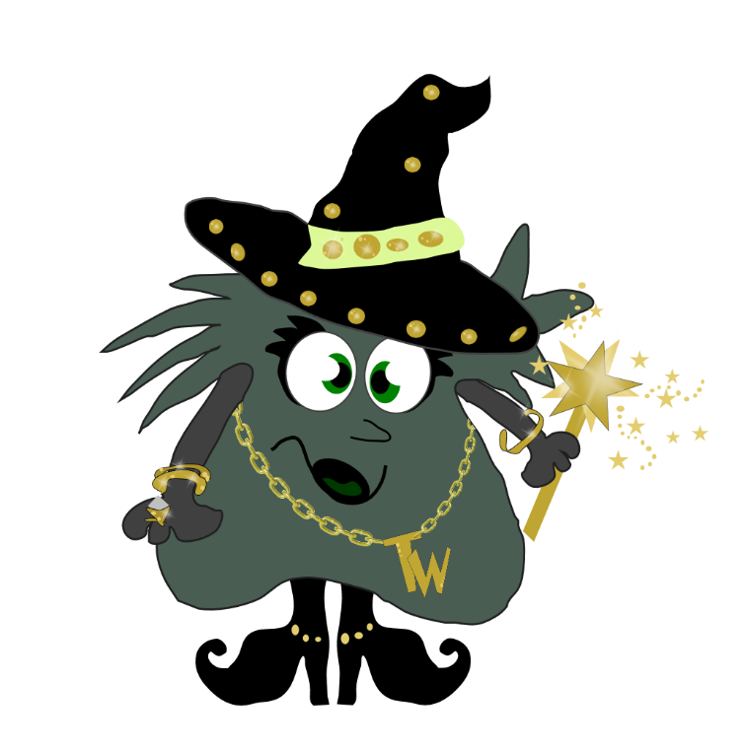

Slide 3
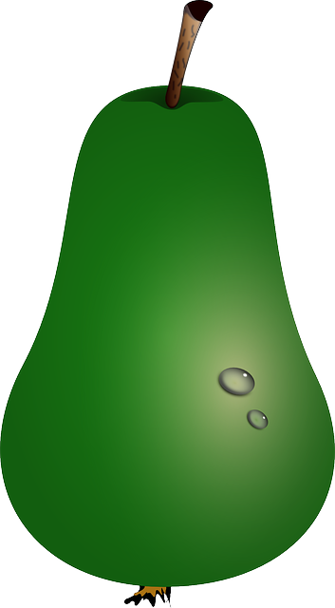
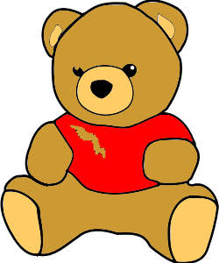

Slide 4
I have a bear.

Slide 5
What does he wear?
A t-shirt with a tear.

Slide 6
‘I balance my pear,’ the bear said.
I balance my pear upon my head.

Slide 7
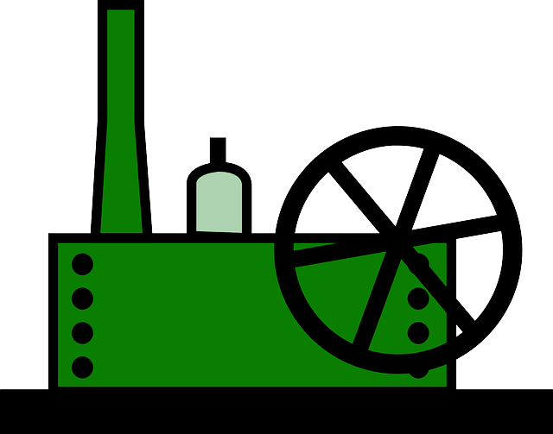
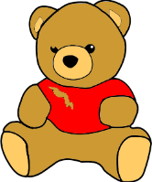
The MORE THAN ONE Machine
bear
bears

Slide 8
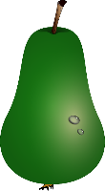
The MORE THAN ONE Machine
pear
pears

Slide 9
near
bear
year
beard
pear
hear
tear
dear
wear

