Slide 1
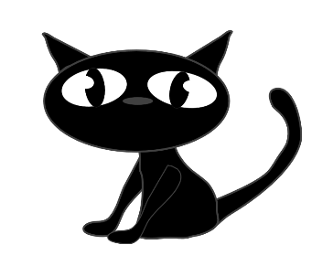
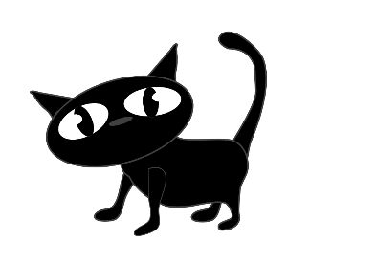
The Black Cats
or

Slide 4
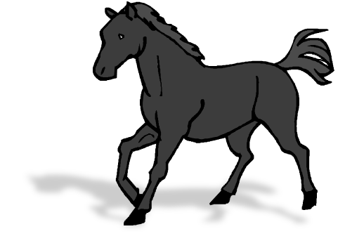
On a stormy night, a farmer forgot about her horse. The horse was left outside in the storm.

Slide 5
The black cats switched on their torch and went to look for her. It was a bad sort of storm.

Slide 6
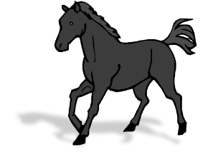
The black cats found the horse. Her horse blanket was worn and torn. But she was not alone!

Slide 7
She had had her baby. A little foal had been born.

Slide 8
stormy
forgot
horse
storm
9
torch
sort
What or words can you remember from the story?
worn
torn
born

Slide 9
