Slide 1
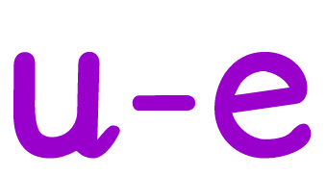
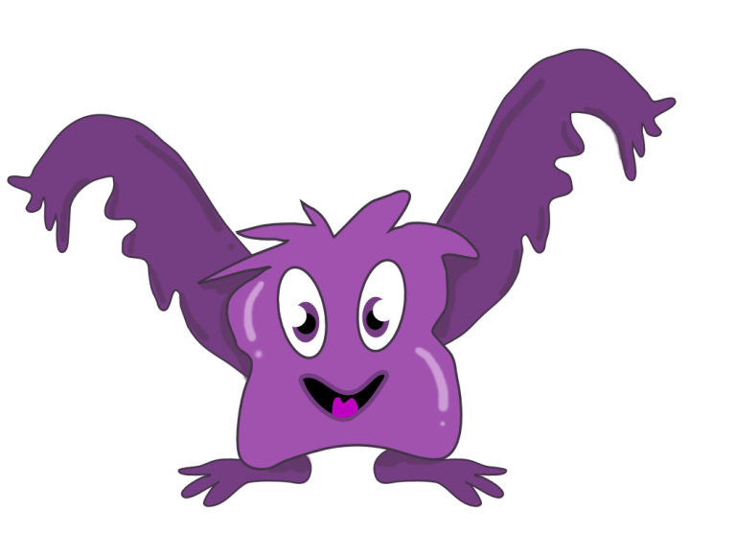

Slide 2
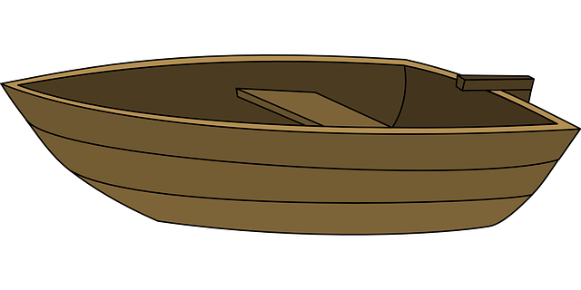
Don’t click until all the words have appeared
tissue
Tuesday
statue
due
value
rescue
argue

Slide 3
