Slide 1
Sleeping Beauty

Slide 2
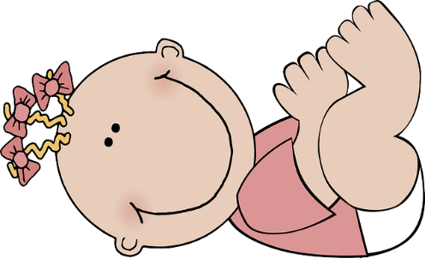
The king and queen had a baby. “We will grant her wishes,” said the fairies.

Slide 3
“We will keep her free from harm,” said the green fairy.

Slide 4
“She will have good teeth and feet,” said the blue fairy.

Slide 5
“She will sleep well and burp when she needs to,” said the pink fairy.

Slide 6
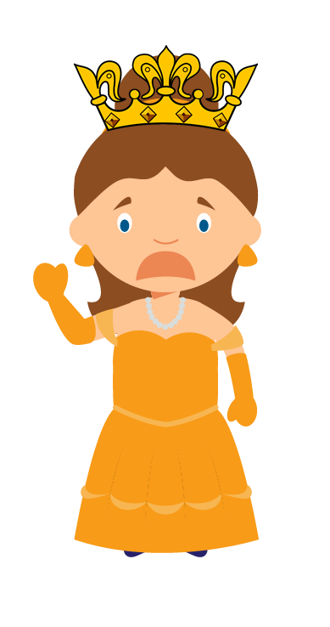
A bad fairy felt left out so she made bad spell.

Slide 7
“When she turns 16 she will prick her finger on a spinning wheel and will die!” said the bad fairy.

Slide 8
Then she vanished out of sight.

Slide 9
“Do not weep. She will not be hurt,” said the green fairy.

Slide 10
“When she pricks her finger she will fall into a deep sleep,” said the blue fairy.

Slide 11
She will keep asleep for 100 years and will wake when a prince kisses her,” said the pink fairy.

Slide 12
So the baby grew into a sweet princess.

Slide 13
“We will keep us all asleep with her,” said the green fairy.

Slide 14
All spinning wheels were not to be seen.

Slide 15
When she turned 16 the princess went to see a part of the castle that she had not seen.

Slide 16
She had not seen a spinning wheel. She pricked her finger and fell into a deep sleep.

Slide 17
Everyone fell into a deep sleep.

Slide 18
Green trees grew so the castle could not be seen.

Slide 19
“This was my plan. Now the castle can not be seen and the princess will not meet her prince. She will stay asleep forever!” said the bad fairy.

Slide 20
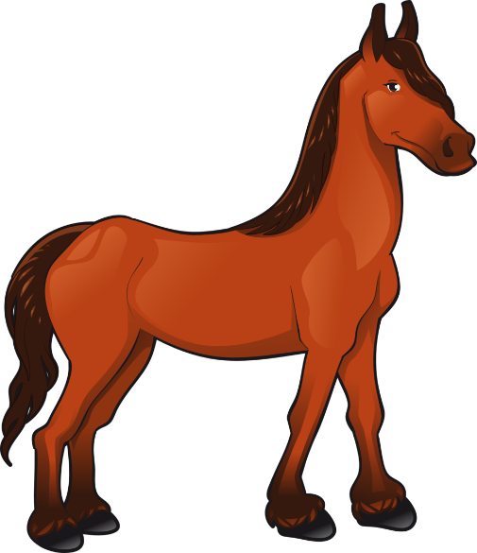
After 100 years a prince went by but he did not see the castle.

Slide 21
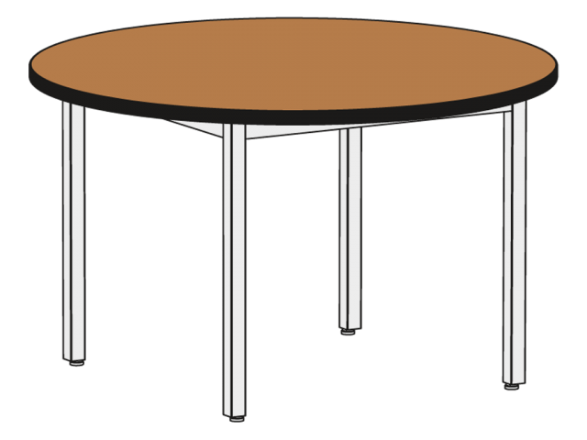
So he went home. He was drinking green tea when he saw Green Froggy!

Slide 22
“Deep in the forest there is a sleeping princess! You need to kiss her to wake her!” said Green Froggy.

Slide 23
So the prince returns! He kisses the princess and she wakes up!

Slide 24
The deep sleep seemed like only a second. Thanks to Green Froggy the story turned into a happy one.

Slide 25
The prince and princess got married in a church.

Slide 26
see
seen
tree
been
green
free
deep
feet
out
turn
weep
meet
when
burp
keep
sweet
will
hurt
sleep
wheel
from
church
teeth

