Slide 1

The 2 sounds of er
shorter longer
stressed unstressed

Slide 2





Slide 3

Longer stressed er
She knew her verbs in
the term time.
Her mum and dad were
happy.

Slide 4






Slide 5
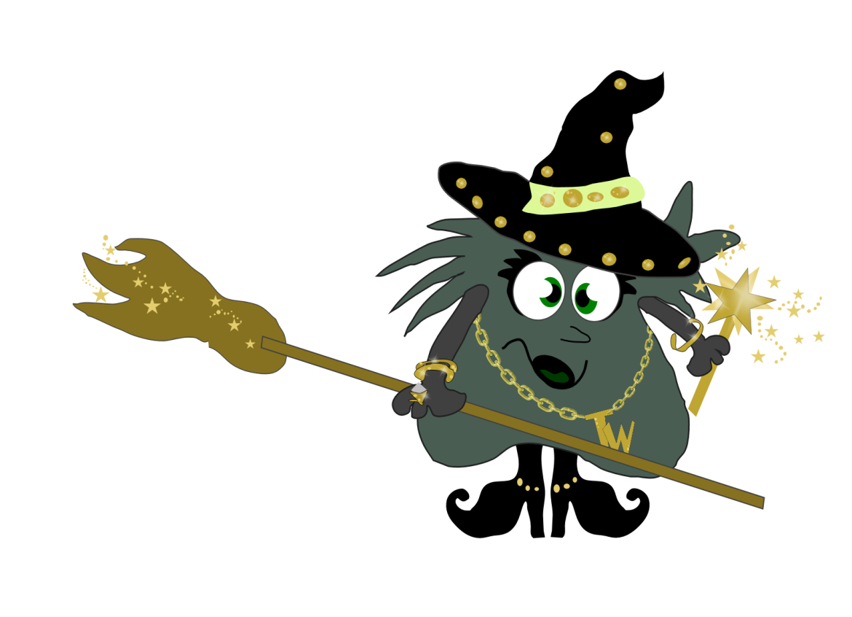

.
After Dinner Mints
Eat them in the summer.
Eat them in the winter.
Better give another to your brother or your sister
Over dinner or after dinner, mints are better than ever
But never let a robber steal them or even a monster!
Hide them under your pillow and keep them forever!

Slide 6
winter

