Slide 1


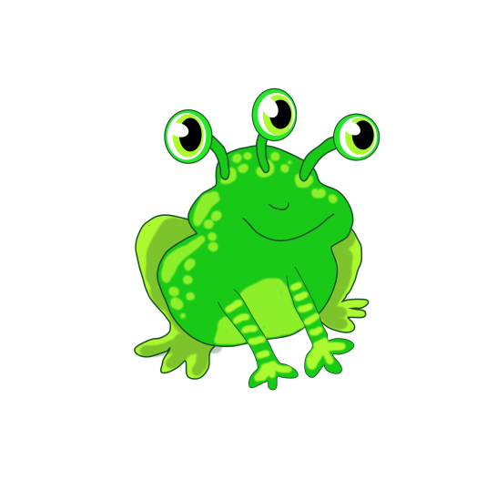





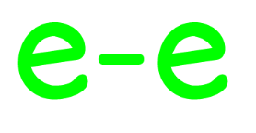
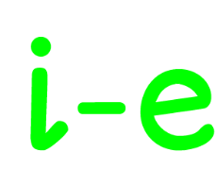

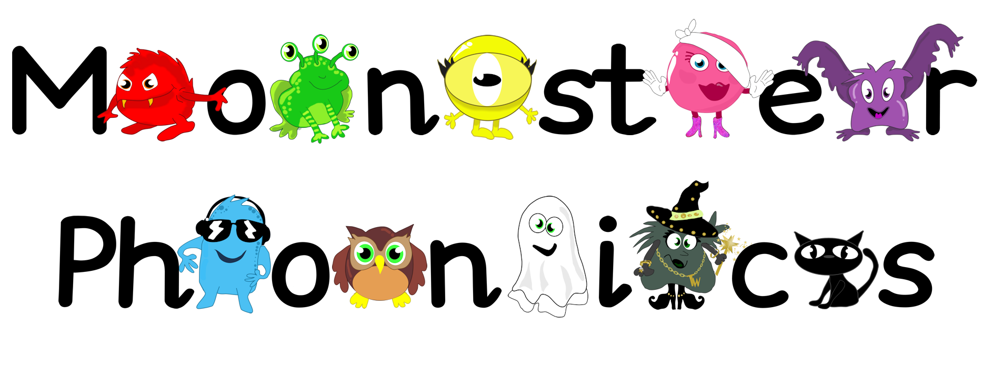
Year 2, Term 1, ey
Green Froggy

Slide 2

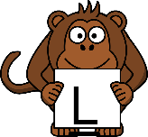



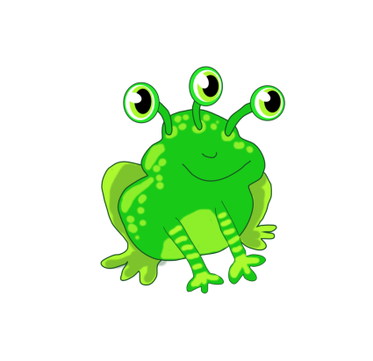






Year 2, Term 1, ey
Click on a monkey !

Slide 3





Year 2, Term 1, ey
Click on a monkey !

Slide 4
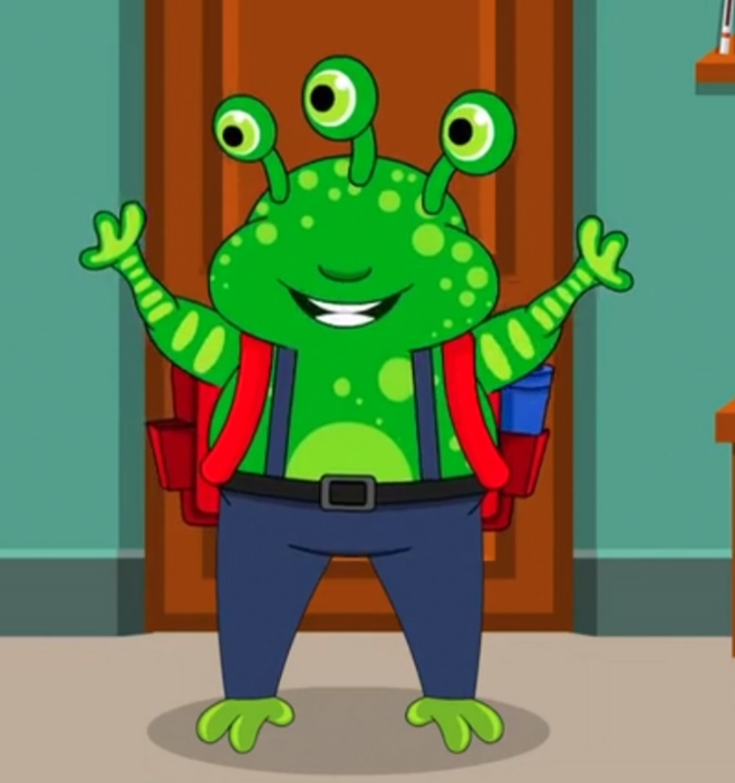
Year 2, Term 1, ey
H
Hello!
My name is Harvey

Slide 5
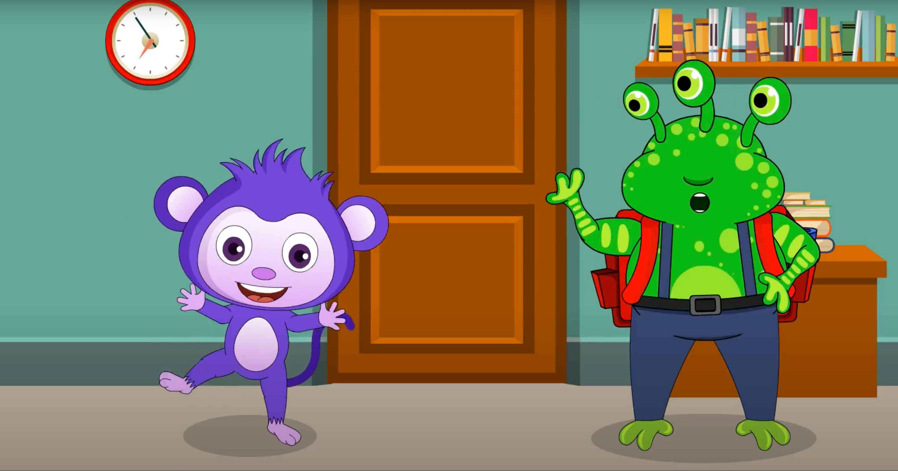
Year 2, Term 1, ey
I want to take Monkey Boo to school!

Slide 6

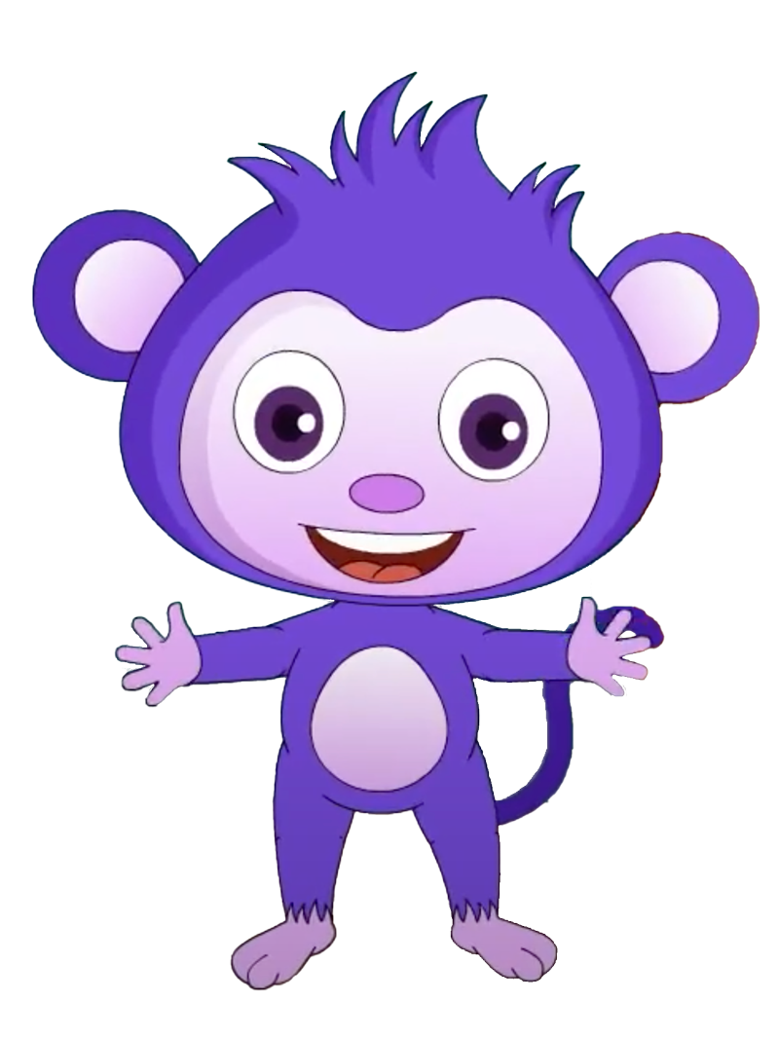
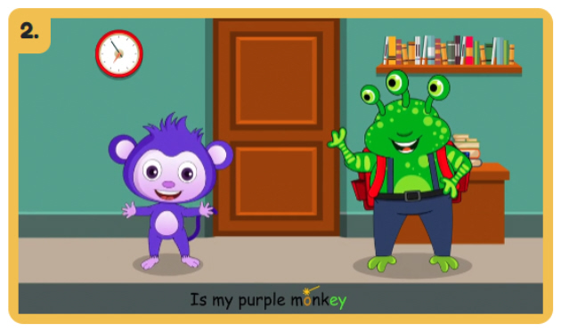
Year 2, Term 1, ey
Watch the Video
Monkey Boo
Return to monsterphonics.com

Slide 7
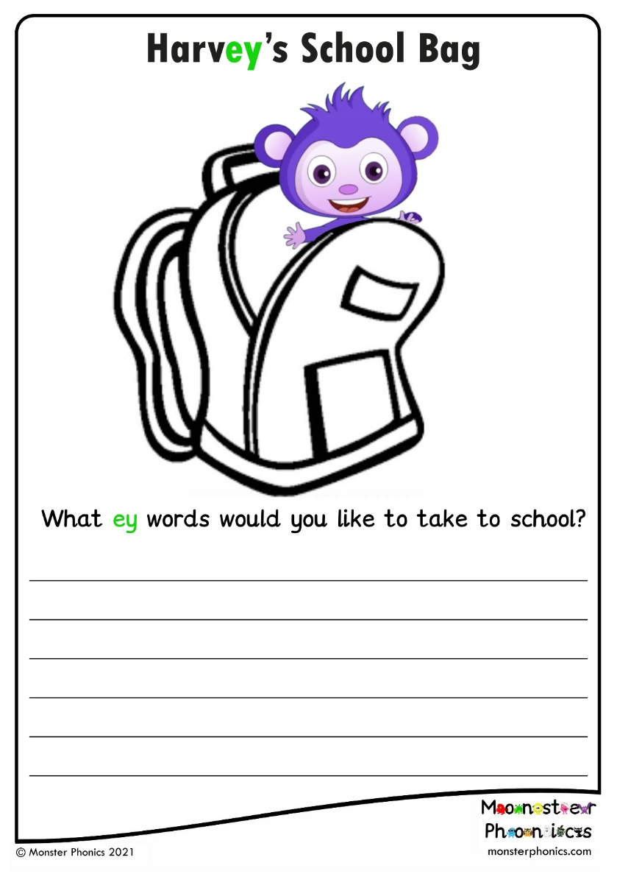
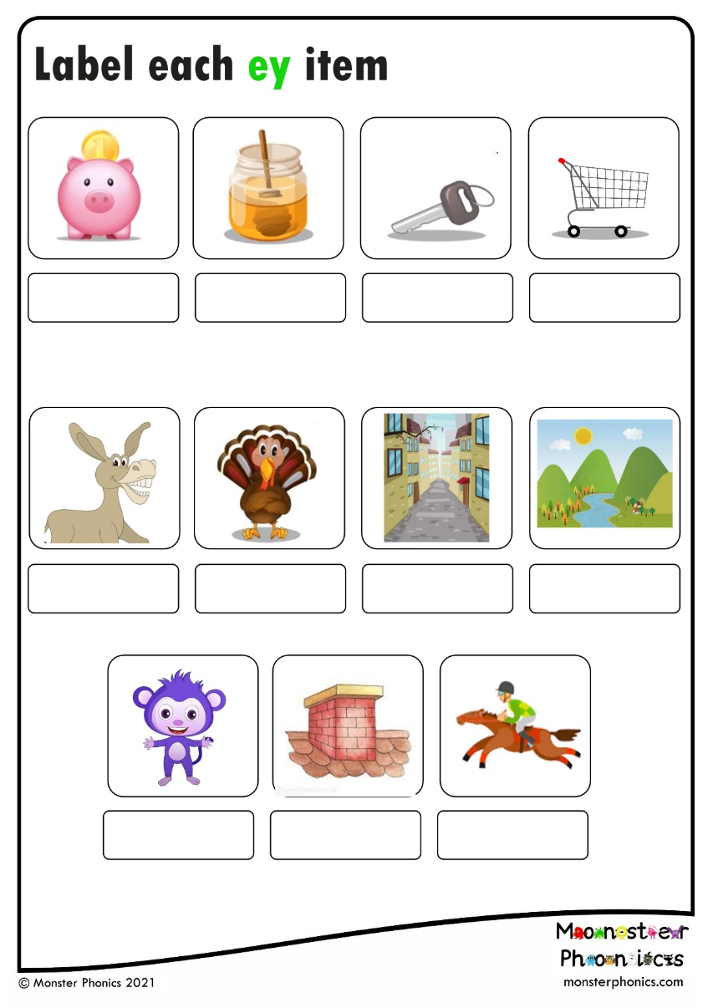
Print out activity
Year 2, Term 1, ey
learn more…

Slide 8
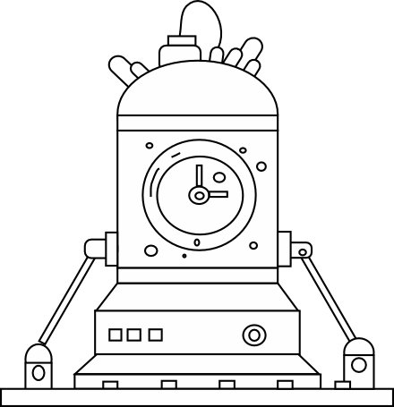
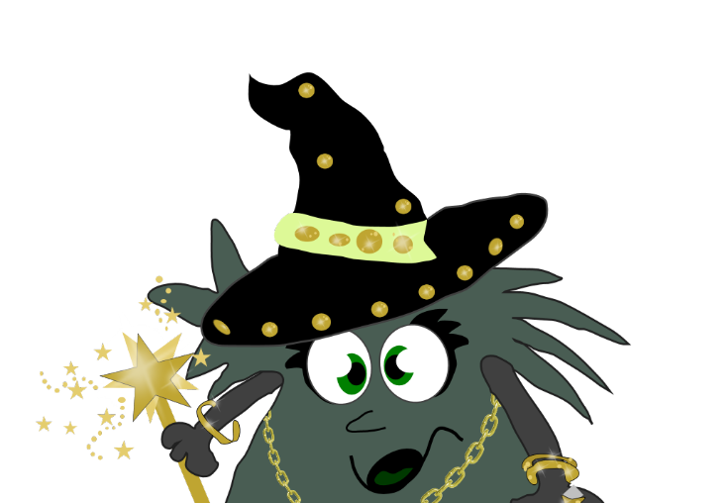
Year 2, Term 1, ey
The MORE THAN ONE Machine
+s
+s

Slide 9
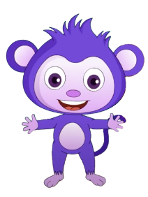



Year 2, Term 1, ey
The MORE THAN ONE Machine
monkey
monkeys

Slide 10
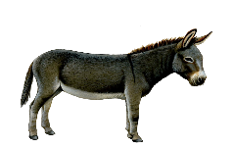

Year 2, Term 1, ey
The MORE THAN ONE Machine
donkey
donkeys

Slide 11



Year 2, Term 1, ey
The MORE THAN ONE Machine
money
money

